Slide 1
PYROTECHNICS

Slide 2
PYROTECHNICS
Learning Objectives
Identify components of the Pyrotechnic Ignition train
Categorize pyrotechnic items based on their design and use.
Identify specific information contained in Data Sheets.
Describe the packaging configurations for various pyrotechnic items.
Identify the importance of color coding pyrotechnic items.
Explain some of the unique hazards associated with pyrotechnics.

Slide 3
PYROTECHNICS
Military pyrotechnics are used for illumination, signaling, simulation of battle noises and effects, and include such items as flares and signals.
Pyrotechnics are designated by Federal Supply Class (FSC) 1370.
All military pyrotechnics are composed of fuels and oxidizers. Typical pyrotechnic fuels include finely powdered aluminum, magnesium sulfur, lactose, or other materials that can be easily oxidized. Oxidizing agents are used to supply oxygen to fuels which allow them to burn at an accelerated rate.

Slide 4
PYROTECHNICS
Material Compositions
Depending upon the military purpose of a pyrotechnic item, its material composition may contain a variety of the following materials:
Binding agent - Used in limited quantities and are currently being replaced by newer materials. Binding agents help hold pyrotechnic components (often in a powdered form) together in a solid mass.
Waterproofing agent - Provide some degree of protection against the effects of moisture.
Retardant - Used to reduce the burning rate of a pyrotechnic mixture to a desired level.
Dyes and salts - Cause pyrotechnic mixtures to emit different colors when they burn and to produce different colored smokes.
Color intensifiers - Increase the intensity of the colors produced during the burn of a pyrotechnic mixture.

Slide 5
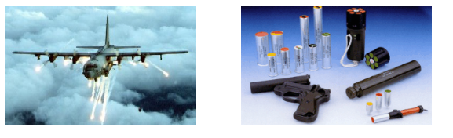
PYROTECHNICS
Methods of Projection
Pyrotechnics may be projected by soldiers using ground or aircraft tactics.
Aircraft pyrotechnics may be mounted in an aircraft or fired by means of a pyrotechnic pistol. Pyrotechnics projected from the ground are fired either by hand or projected from pyrotechnic pistols, small arms ammunition cartridges, hand-held expendable launchers, or manually operated projectors.

Slide 6
PYROTECHNICS
Pyrotechnic items function by means of an ignition train. Each ignition train component performs a specific function at a point in the ignition sequence.
All pyrotechnic items have an initiator and a main charge. There are no features to interrupt the train once initiated, so each component will function.
Initiators
Electric primer - Initiated by application of an electrical current.
Percussion primer - Initiated by striking with a firing pin or other type of striking device.
Friction igniter - Initiated by an abrasive force applied to match head type material.
Chemical igniter - Initiated as the result of a chemical reaction.

Slide 7
PYROTECHNICS
Other Components
Propelling Charge- The propelling charge consists of either black powder or a double-based propellant. Its purpose is to propel the main pyrotechnic charge high into the air, or away from personnel or aircraft.
Delay Element- The delay element usually consists of a solid black powder pellet. Its purpose is to allow for a safe separation distance for personnel and equipment and to enhance the effectiveness of an item.
Expelling Charge- A small charge of black powder typically used to expel the main charge from its casing or container. The expelling charge is often used to initiate the main charge.
Quickmatch- A cotton cord mixed with black powder to act as a fast-burning fuse. Quickmatch is often used in ignition trains to ensure that the burn is transferred from one element to another.
Main Pyrotechnic Charge- The main charge designed to produce the desired effect. The main charge will usually consist of an illuminant, smoke, color, or flash composition.

Slide 8
PYROTECHNICS
Pyrotechnics may be categorized according to their use as:
Signals
Flares
Simulators
Smoke Pots
Photoflash Cartridges
Miscellaneous

Slide 9
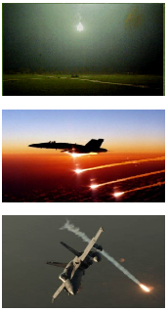
PYROTECHNICS
Flares
Flares are used to produced light or heat and can be projected from aircraft or launched from the ground. These pyrotechnic items may be further categorized according to use; illuminating, countermeasure, and infrared.
Illuminating flares are used to illuminate a wide area during tactical situations. They are generally classified by projection (aircraft or ground) and illuminating power.
Countermeasure flares are used to produce tremendous heat which causes heat-seeking missiles to track the flare instead of the heat emitted from aircraft.
Infrared (IR) flares are used as countermeasures against missiles and artillery rounds that lock on to an IR source.

Slide 10
PYROTECHNICS
Signals
Signals are used to produce colored or light smoke for the purpose of tactical communication. They typically produce:
light of various intensities, duration, and color
smoke of various colors and densities
sound of various degrees
any combination of the above

Slide 11
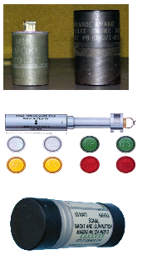
PYROTECHNICS
Signal Types
Signals can be categorized as ground, aircraft, and distress. Click each image for a brief description.

Slide 12
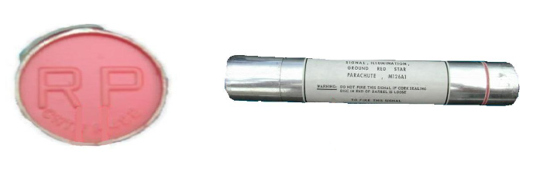
PYROTECHNICS
Identification
The color and configuration for pyrotechnic signals is indicated on its label and is also embossed on the lid of its inner packaging to aid in identification at night.

Slide 13

PYROTECHNICS
Photoflash Cartridges
Photoflash cartridges are designed to produce intense bursts of light for night time aerial reconnaissance photography.
These cartridges consist of an aluminum case with an electrically initiated primer, a propelling charge, and an inner case which houses a delay element, detonator, and the main charge of the flash powder. They are fired from a specially designed ejector which is mounted onto aircraft.

Slide 14
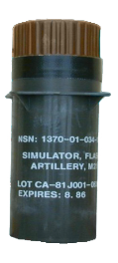
PYROTECHNICS
Simulators
Simulation pyrotechnics are used to simulate the effects of actual munitions. They are commonly used in training scenarios and offer the advantages of cost and safety.
Training with actual high explosive ammunition can be very expensive. Simulators are less expensive and are still capable of providing the flash and noise effects of actual service rounds.
Most simulator bodies are constructed of cardboard or plastic, which greatly reduces their fragment hazard distance. They also use much less explosive material than service rounds.

Slide 15
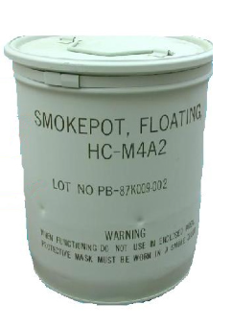
PYROTECHNICS
Smoke Pots
Smoke pots are large in size and are designed to produce very large volumes of smoke.
A smoke pot is a portable steel container filled with a smoke producing agent. Screening smokes are always white in color and are used to obscure military movements or mark target areas for artillery and bombs.

Slide 16
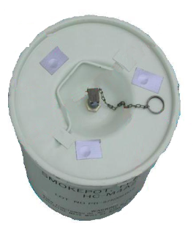
PYROTECHNICS
Types
Smoke pots may be of either land or floating type.
Land type smoke pots (illustrated at left) contain an HC(Hexachloroethane) smoke mixture (10-pounds or 30-pounds), and are initiated manually. They produce large volumes of smoke for 8-minutes (10-lb) or 22-minutes (30-lb).
Floating type smoke pots contain HC or fog oil. The upper third of the container is an air chamber that permits the smoke pot to float in the water. The main HC or fog oil charge will burn for a maximum of 15-minutes.

Slide 17
PYROTECHNICS
Miscellaneous
Miscellaneous pyrotechnics are used for unique applications that do not fall into any of the previous categories mentioned. These items include:
Railroad fusees
Fire starters
Incendiary destroyers
These miscellaneous pyrotechnic items will be covered in more detail on the following pages.

Slide 18
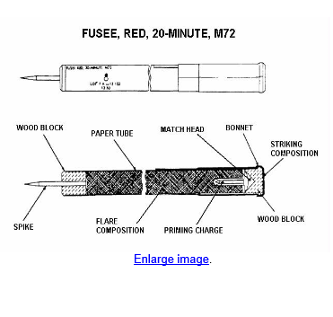
PYROTECHNICS
Railroad Fusee
Railroad Fusees are used to outline emergency airfield boundaries and for recognition of signaling along railroad right-of-ways.
These fusees consist of a paper tube filled with a red flare composition. A spike on one end of the tube secures the fusee to the ground.
Components of the fusee include a match head, priming composition, and flare composition. Burning time is 10-, 15- or 20-minutes.

Slide 19
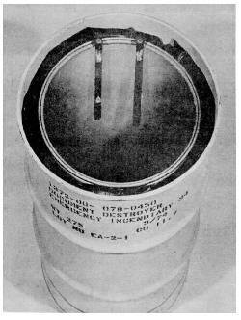
PYROTECHNICS
Incendiary Destroyers
Incendiary destroyers contain ignition materials and oxidizing agents. These devices are used to quickly destroy classified documents in emergency situations to prevent them from falling into enemy hands.
More specifically, the M4 Document Destroyer (illustrated at right) consists of a 55-gallon metal outer drum and other miscellaneous components. It contains an oxidizing agent of either sodium nitrate coated with calcium phosphate or prilled sodium nitrate. The oxidizing agent fills the space between a fiberboard inner drum and a metal outer drum and provides the oxidizer required to support combustion of the documents being destroyed.

Slide 20
PYROTECHNICS
Pyrotechnic Color-Coding
Since pyrotechnics are often used for signaling purposes during combat, it is extremely important to use the right type of signal to convey the intended message.
Depending upon the item, there are usually one or more ways to identify its intended effect. These methods include:
Labeling of the item as well as its inner- and outer-packaging.
Color-coding of the item or the item inner packaging.
Embossing of the item or the item inner packaging.
General color-coding specifications will be covered on the following pages. For more detailed specifications regarding pyrotechnic color-coding, consult the respective page of the TM 43-0001-37.

Slide 21
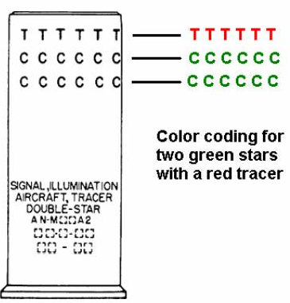
PYROTECHNICS
Star Signals
Star signals are color-coded to identify the colors of each star in the signal and also indicate if a tracer is present.
A band of Cs is marked at the forward end of the signal for each star in that signal. For example, a single-star signal would have only one band and a double star-signal two bands of Cs.
Each band is marked using the same color as the star. A band of Ts indicates that a tracer is present and also indicates its color.

Slide 22
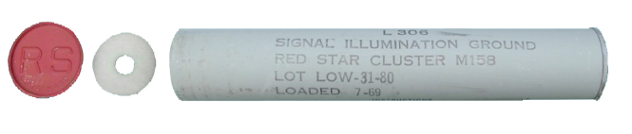
PYROTECHNICS
Ground signals
Ground signal inner packaging is identifiable by either a paper label or stencil. The lids of these packagings are also painted the color of the main charge.
To help identify these items at night, the lids are also embossed with one or two letters to signify both the color and the effect of the charge.

Slide 23
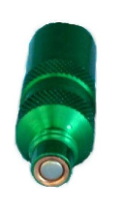
PYROTECHNICS
Pen Flares
The cork sealing disk of pen flares (visible after the firing cap is removed) is painted to identify its color. Small cartridges for pen flares usually have anodized bodies to match the color of their effect.

Slide 24
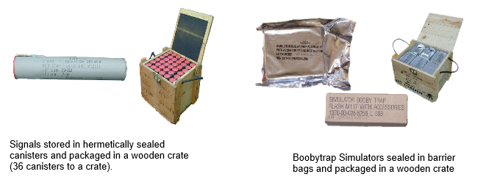
PYROTECHNICS
Packaging
Pyrotechnic items are packaged in accordance with Department of Transportation (DOT) regulations to protect them during routine storage, handling, and transportation. Since pyrotechnic mixtures often deteriorate more rapidly than other types of explosives, their packaging usually consists of an additional level of protection against elements such as moisture. This often includes the use of barrier bags, desiccants (small cotton pouch filled with an absorbing agent), humidity indicators, and hermetically-sealed metal cans.

Slide 25
PYROTECHNICS
Safety Precautions
Safety precautions must always be observed when storing, handling, and transporting any type of explosive, pyrotechnic devices being no exception. As a matter of fact, pyrotechnic compounds are usually more sensitive to friction, shock, or static than most other types of military explosives. In addition to their main charge, they often have fairly sensitive initiation elements, such as friction compositions and primers.
On the following pages, you will learn some of the safety precautions applicable to pyrotechnic items.

Slide 26
PYROTECHNICS
General Precautions
General safety precautions applicable to pyrotechnic items include: •Handle pyrotechnics with care at all times.
  Never throw or drop boxes of pyrotechnic items.
  Store pyrotechnics in a dry, well-ventilated area away from direct sunlight.
  Protect pyrotechnics from temperature extremes.
  Protect percussion primers against accidental impact.
  Ensure electrical primers and ignition wires are properly shunted.
  Protect pyrotechnic items from unnecessary exposure to moisture.
  Report damaged and/or leaking rounds.
  Never attempt to disassemble a pyrotechnic device.
Pyrotechnic compositions are particularly susceptible to deterioration by moisture. If pyrotechnic mixtures that contain powdered metals are exposed to moisture, chemical reactions can occur which result in the production of hydrogen gas, which is very dangerous.

Slide 27
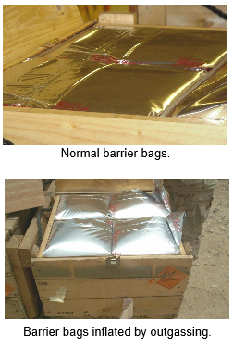
PYROTECHNICS
Hydrogen Gas Build-up
Hydrogen gas is highly flammable and can be ignited by a simple discharge of static electricity.
Hydrogen gas has the potential to accidentally ignite the pyrotechnic train of an item. In addition, the pressure build-up from this "out-gassing" can rupture certain pyrotechnic assemblies, and cause barrier bags, and even outer packaging, to expand and bulge. Opening an outer package under this kind of pressure can result in serious injuries.
To prevent injury to personnel, boxes in this condition must be placed in a locally fabricated containment fixture prior to cutting any banding straps. Barrier bags can then be removed to an open, well-ventilated area that is free from open flame, flammable materials, and other explosives.
Personnel wearing protective equipment (face shield, flame retardant coveralls, etc.) and who are properly grounded may puncture the inflated bags with a non-sparking pick.

Slide 28
Questions

